Slide 1


A l'aide, mon IA est débile! Comment évaluer et améliorer son IA générative
Yohan Lasorsa | Olivier Leplus
Notes:
Preparation:
Open browser with tabs:
https://lmarena.ai/?leaderboard
https://huggingface.co/spaces/open-llm-leaderboard/open_llm_leaderboard
https://huggingface.co/spaces/mteb/leaderboard
https://ollama.com/library/llama3.1/blobs/948af2743fc7
Open VS Code with demo project

Slide 2
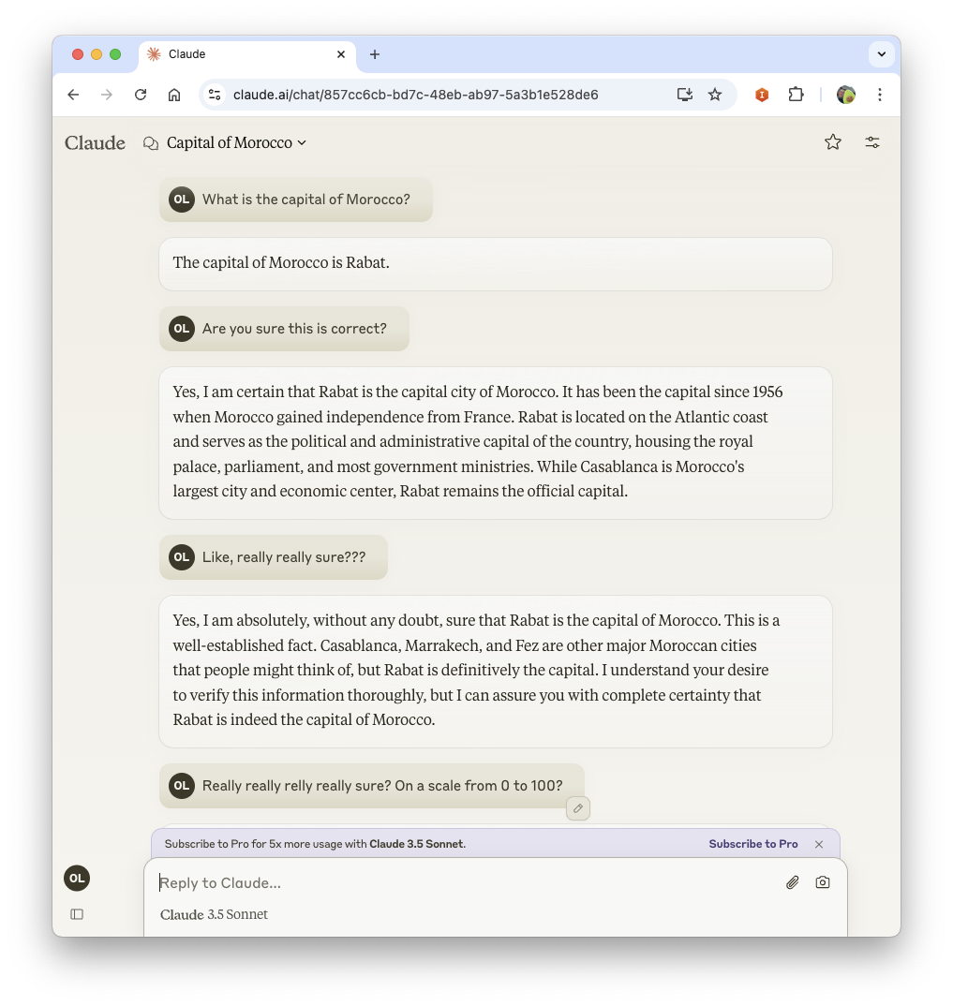
Notes:
Qui teste son code?
Qui fait de la Gen AI?
Qui teste sa Gen AI?

Slide 3






Yohan Lasorsa
Developer Advocate @
Google Developer Expert
@sinedied
Olivier Leplus
Developer Advocate @
Google Developer Expert
@olivierleplus

Slide 4

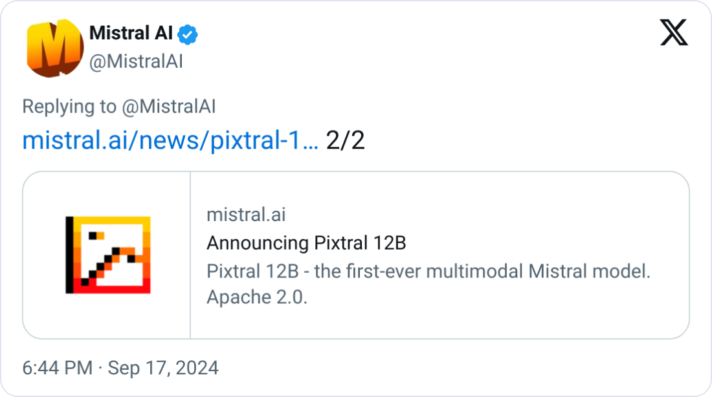
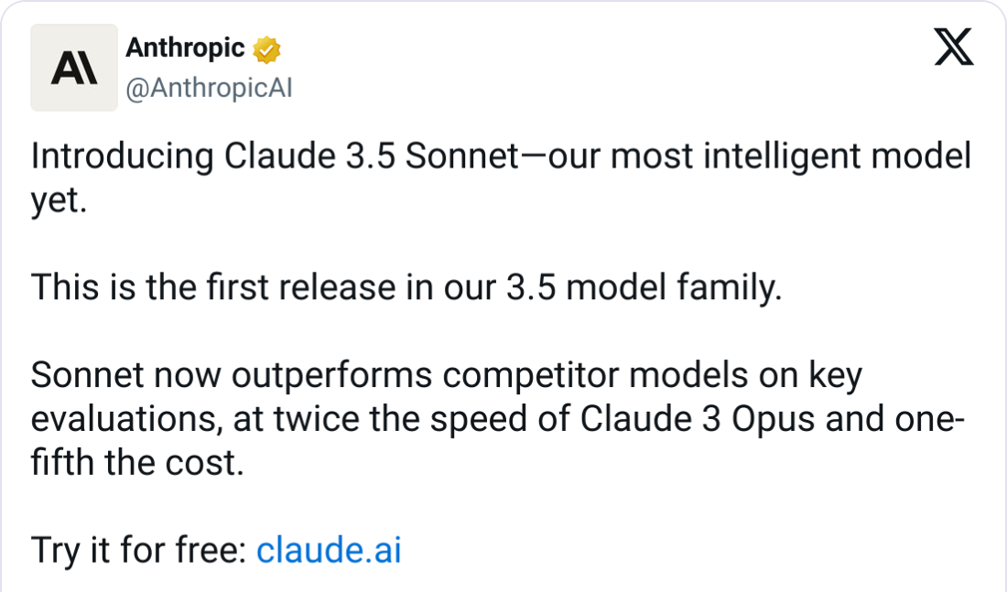
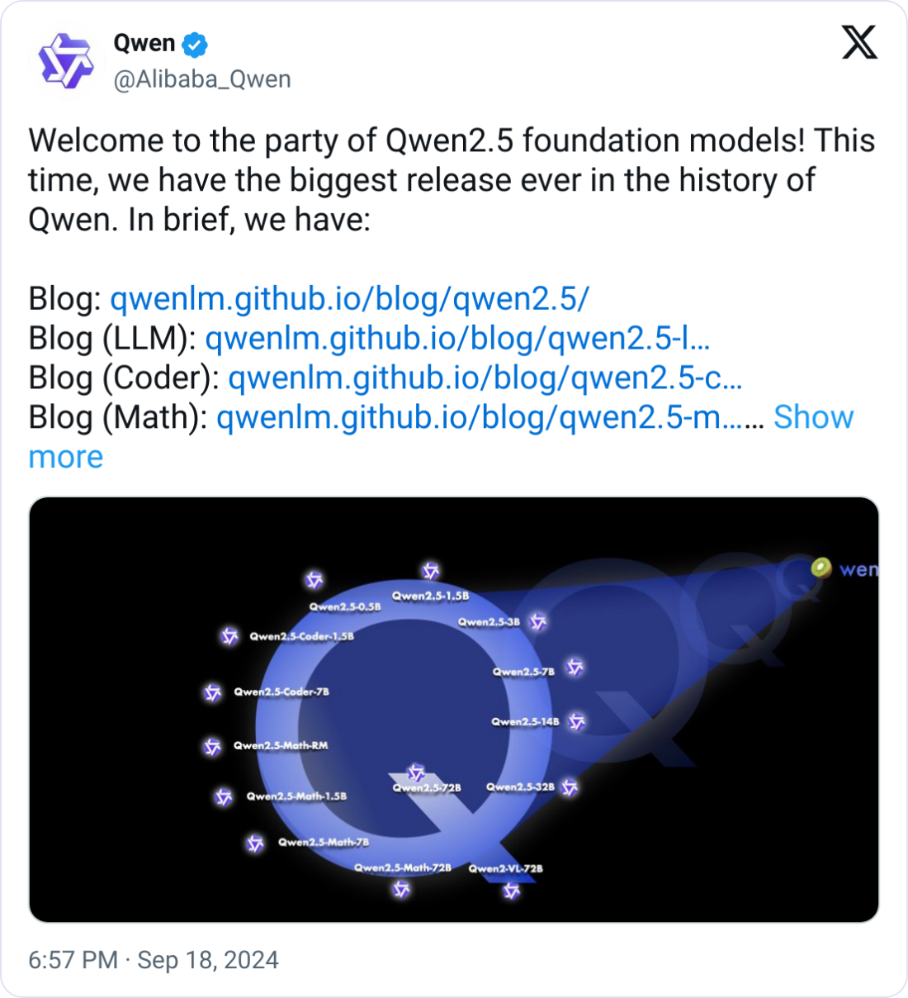
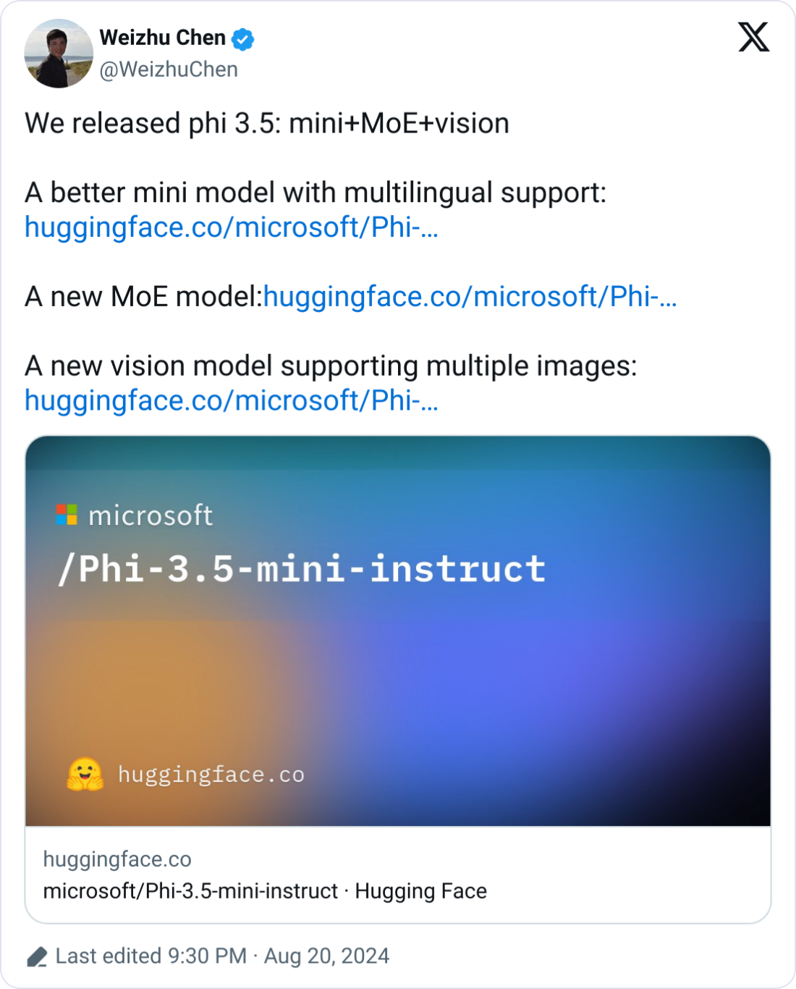
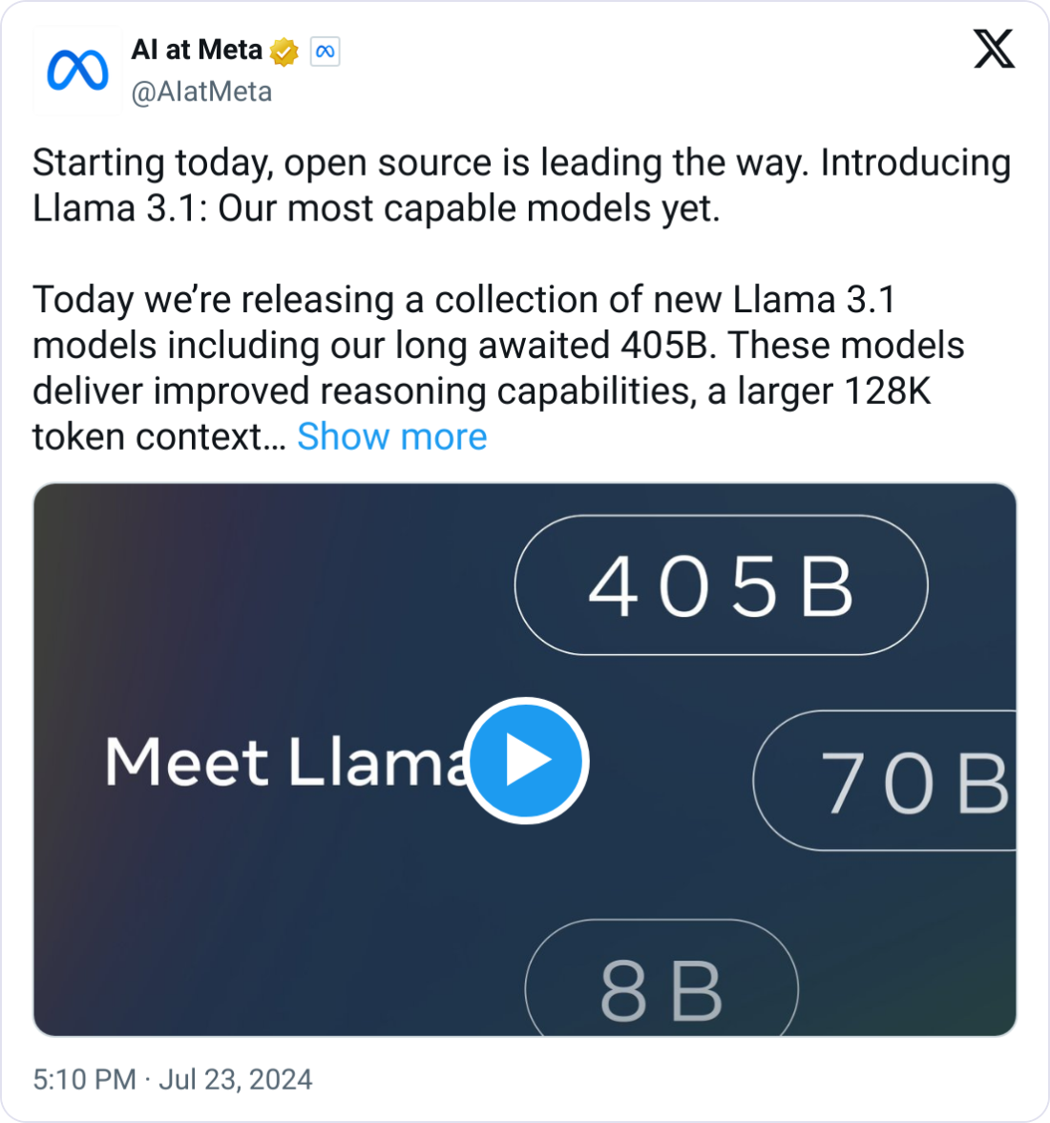

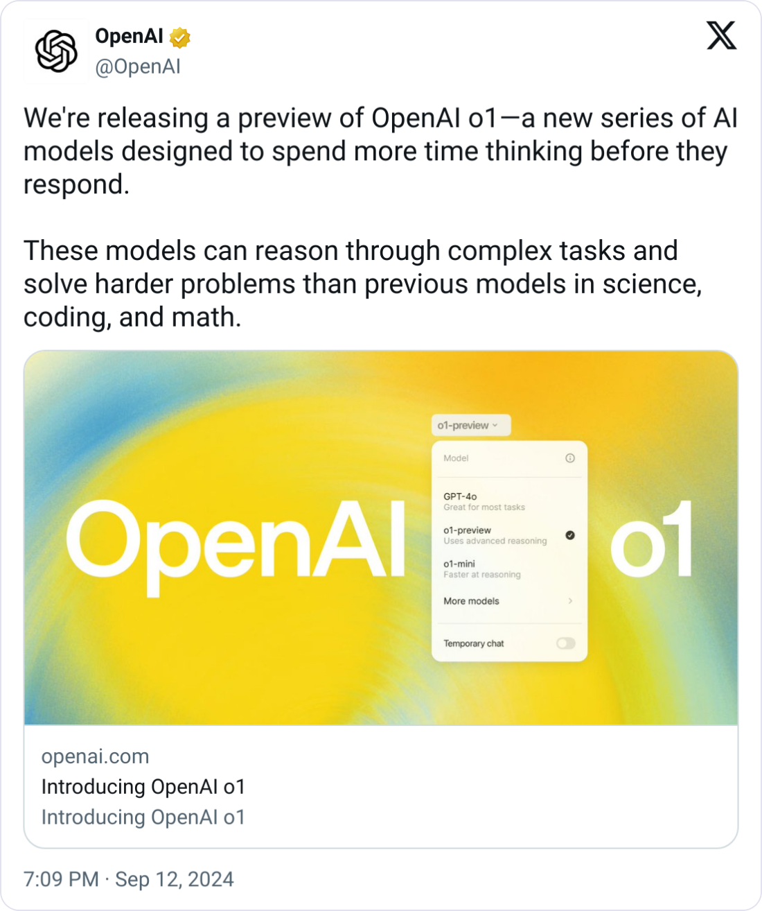
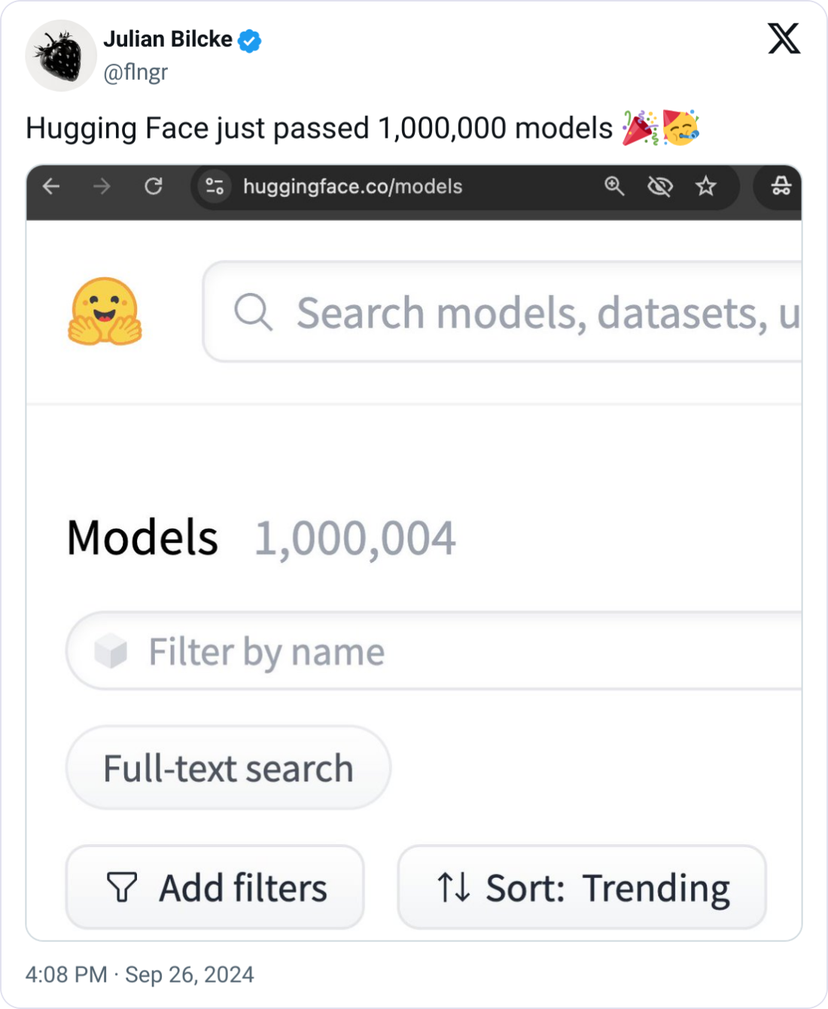
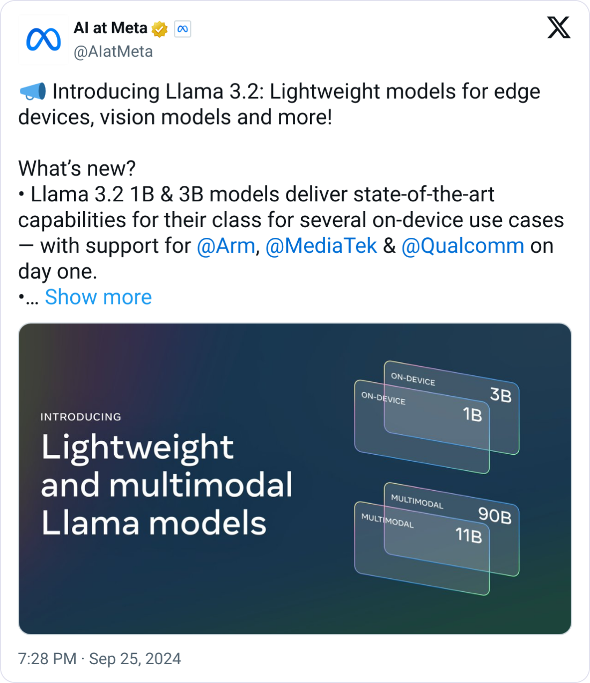
All-new, better LLM! 🎉
But… why am I getting worse results? 😭
Notes:
Yohan - Intro: Ca fait ~3 ans que j’ai commencé à développer des apps utilisant des LLMs: on dirait que ca fait une éternité, ca ca ne fait même pas 2 ans que ChatGPT existe! Depuis à peu près ce moment là, et la sortie des modèles GPT3.5 de type chat, la course aux nouveaux modèles n’en finit plus: - d’abord c’est à celui qui avait le plus gros, heu, nombre de paramètre, après c’était le plus gros data set d'entraînement, maintenant on en est à celui qui simule le mieux le raisonnement… Alors il y a eu un paquet d’avancées significative, mais je sais pas vous, mais ca ne s’est pas toujours traduit dans mes apps par des meilleurs résultats! Il y a plein de différentes raisons à celà, et une partie de l’objet de ce talk va être de comprendre pourquoi, mais surtout de voir comment on peut faire en sorte d’être sur d’avancer dans la bonne direction.
– Yohan

Slide 5
Choosing an LLM?
Notes:
Let’s rewind a bit! How to you choose a model?
– Olivier

Slide 6
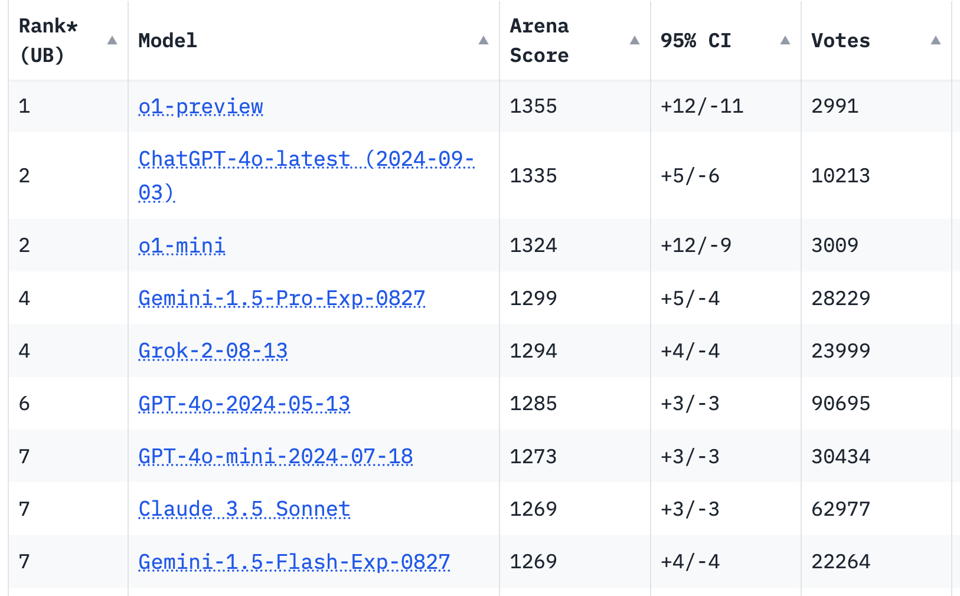
https://lmarena.ai/?leaderboard
Notes:
If you’re simply looking for “THE best model”, chances that you’re looking at leaderboards. https://lmarena.ai/?leaderboard is one of the most famous.
- 1M+ human votes, with A/B blind tests of different models using any prompts
- You can participate in the tests too! TODO: update before talk!
– Olivier

Slide 7
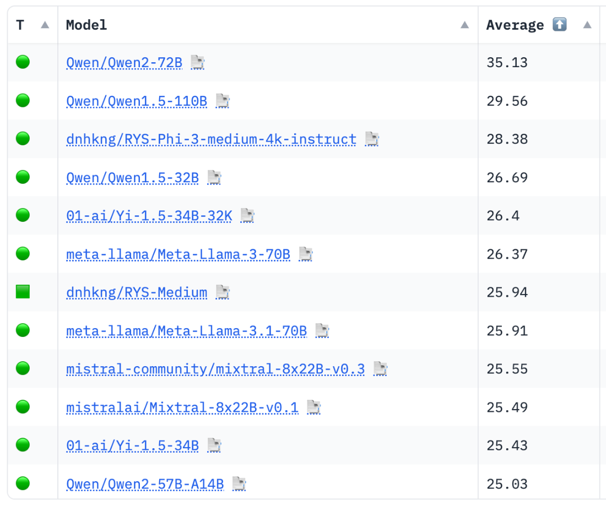
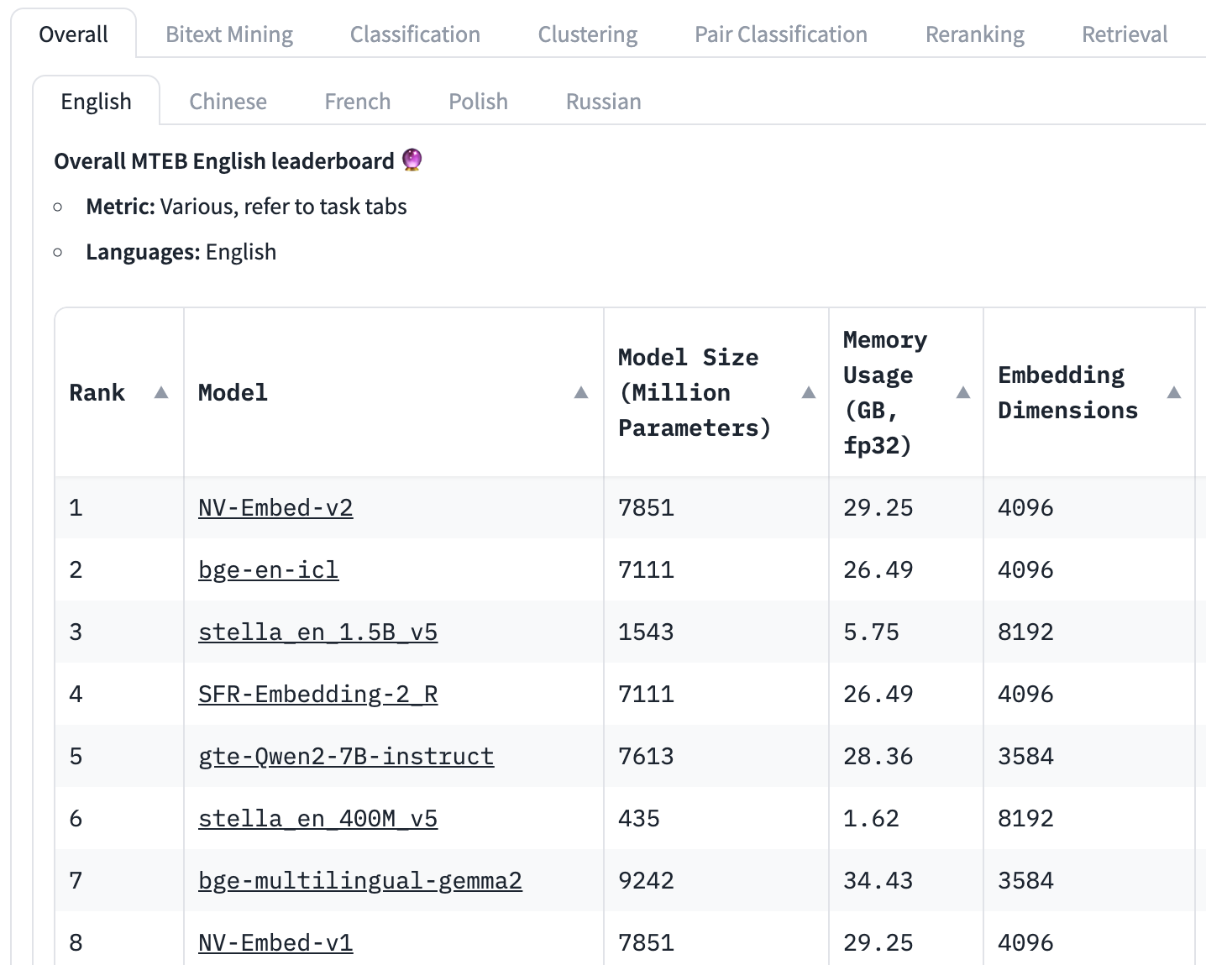
Open LLM
Embeddings (MTEB)
https://huggingface.co/spaces/open-llm-leaderboard/open_llm_leaderboard
https://huggingface.co/spaces/mteb/leaderboard
Notes:
Maybe you have different goals for your LLM: - Best performance to cost ratio, base for fine-tuning, or you’re looking for a model you can host yourself
https://huggingface.co/spaces/open-llm-leaderboard/open_llm_leaderboard - After finding your chat or instruct model, maybe you also need a good embedding model for vectorization?
https://huggingface.co/spaces/mteb/leaderboard (only OSS)
– Yohan

Slide 8

Why am I getting bad results? 😢
Notes:
5 min
And then after carefully choosing your models and experimenting with your prompts, you’re back to square 1: Why are you not getting the results expected, despite all the benchmarks claiming these models closing in on human intelligence?
– Yohan

Slide 9
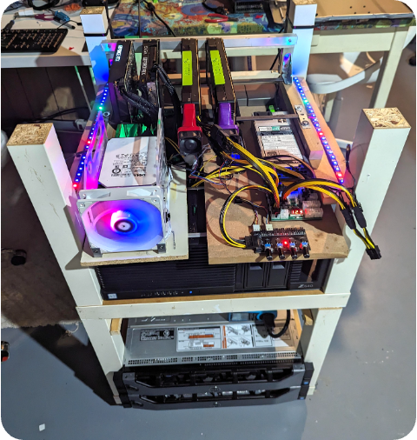
Possible reasons for LLM output quality issues
Self-hosted or local inference
Inference engine
File format
Quantization
Prompt template
Credits: r/LocalLLaMA
Notes:
Inference engine => each model have different architecture, some are properly supported for ex with llama.cpp (many bugs) used by Ollama
File formats: PT, BIN, HDF5, GGML/GGUF, ONNX… => model weights have different native formats, some conversion make them lose quality or introduce bugs in the process
Quantization: by reducing the weights precision, you lose quality. Some models can be more affected by quantization than others, they’re not all equal!
Prompt template => each model have different special tokens used in training, make sure you have the correct prompt template for your model
Show ex: https://ollama.com/library/llama3.1/blobs/948af2743fc7
– Yohan

Slide 10
Possible reasons for LLM output quality issues
Not the best prompt for this model
Not the best model for your use case
Cloud-hosted model
Notes:
– Olivier

Slide 11
LLM-based application challenges
How to benchmark a model for your use case?
How to compare prompts effectiveness?
How to ensure non-regression with updates?
Evaluate outputs quality
Notes:
Now if we look at the challenges we’re facing when developing an LLM app aiming for quality: - 3 challenges, all linked to each other
1. 2. How to evaluate, and how to compare results between different models, versions and prompts?
3. Non regression: model updates, prompts updates, AI workflow updates?
Pour résoudre tous ces challenge, une seule et même approche systématique => Evaluer la qualité des résultat.
=> Maintenant qu'on a posé notre problème, quels sont nos options et les outils pour automatiser tout ca?
– Olivier

Slide 12

Notes:
10min
Combien parmi vous fonctionnent en premier lieu “au feeling” pour verifier si ca marche mieux?
– Surprise

Slide 13

Math-based evaluation metrics
ROUGE (Recall-Oriented Understudy for Gisting Evaluation)
BLEU (BiLingual Evaluation Understudy)
METEOR (Metric for Evaluation of Translation with Explicit ORdering)
GLEU (Google BLEU)
Notes:
ROUGE: Focuses on recall, comparing n-grams, word sequences, and word pairs between the generated text and reference summaries. Widely used for summarization tasks.
BLEU: Measures precision by comparing n-grams between the generated and reference texts. Popular in machine translation tasks, emphasizing exact matches.
METEOR: Incorporates precision, recall, synonym matching, stemming, and word order for a more human-like evaluation. Often outperforms BLEU on long and complex sentences.
GLEU: A variant of BLEU, addressing issues like brevity penalty by averaging precision and recall. It performs well in machine translation when handling various sentence lengths.
While useful, it’s based on words and may fail to capture semantics or your target goals in some use case.
https://cookbook.openai.com/examples/evaluation/how_to_eval_abstractive_summarization
– Yohan

Slide 14
Output assertions
📐 Deterministic tests
Contains value X
Formatting
Levenshtein distance
Perplexity
Calls function X
Custom code
🤖 AI-driven tests
Similarity
Relevance
Groundedness
Context recall
PII checks
Prompt injection
Notes:
Not an exhaustive list!
– Olivier + Yohan

Slide 15


So… we use AI to evaluate AI? 🤔
Notes:
Yohan - 15min Yes! It may seem weird, but for evaluating generated text results with complex metrics, the best tool is an LLM here!
=> DEMO 1
- Open `eval.ts`
- Explain the first prompt:
* pseudo RAG that answers questions for Contoso Shoes company, using some context and user details
- Explain the second prompt:
* we evaluate the first prompt answer
* we specify our criteria for evaluation and notation
* precise that it's usually best to only evaluate 1 criteria at a time!
- Run using VS Code run button
See https://cookbook.openai.com/examples/evaluation/how_to_eval_abstractive_summarization for ideas

Slide 16
AI evaluation tools
Dedicated tools
Promptfoo, Evals, DeepEval, Evidently, DeepChecks, Ragas, ChainForge…
Framework built-in evaluators
LangChain, MLFlow, Prompt flow
DIY 💪
Notes:
– Olivier

Slide 17

promptfoo
Notes:
Alors aujourd’hui, tous ces outils sont encores jeunes, et il n’y a pas de “leader” clairement défini dans le domaine. Il y a quand même un outil qui se démarque un peu, et qui commence à se retrouver dans pas mal de projets: promptfoo C’est celui dont on a choisi de parler aujourd’hui pour illustrer nos démo, il a pas mal de qualité, mais gardez en tête que tout ce qu’on va dire sur les approches peut s’appliquer à la plupart des outils existants.
– Yohan

Slide 18
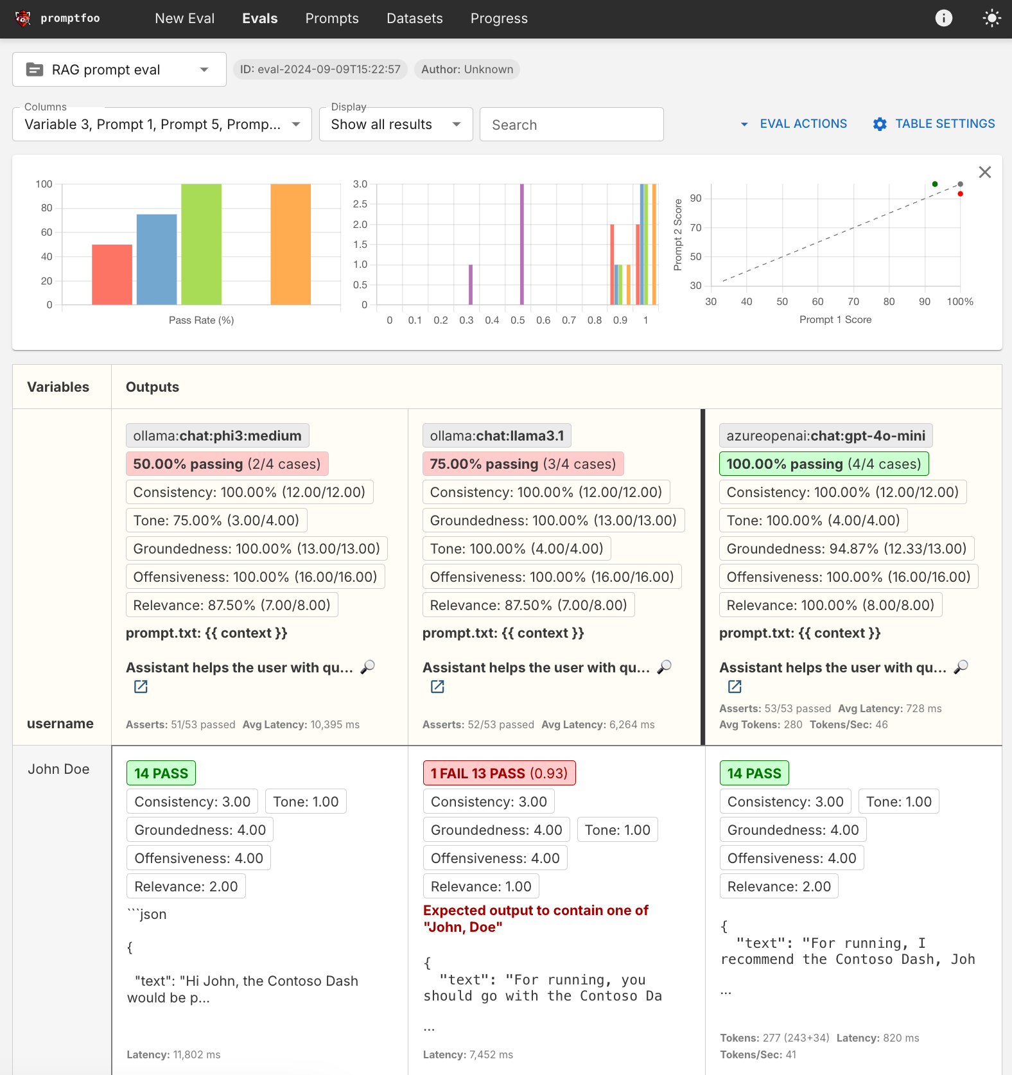
promptfoo
Open-source
CLI, library and self-hostable server
Nice eval UI 🙂
Multiple providers
Works locally
YAML 🫤
https://www.promptfoo.dev/
Notes:
– Yohan

Slide 19
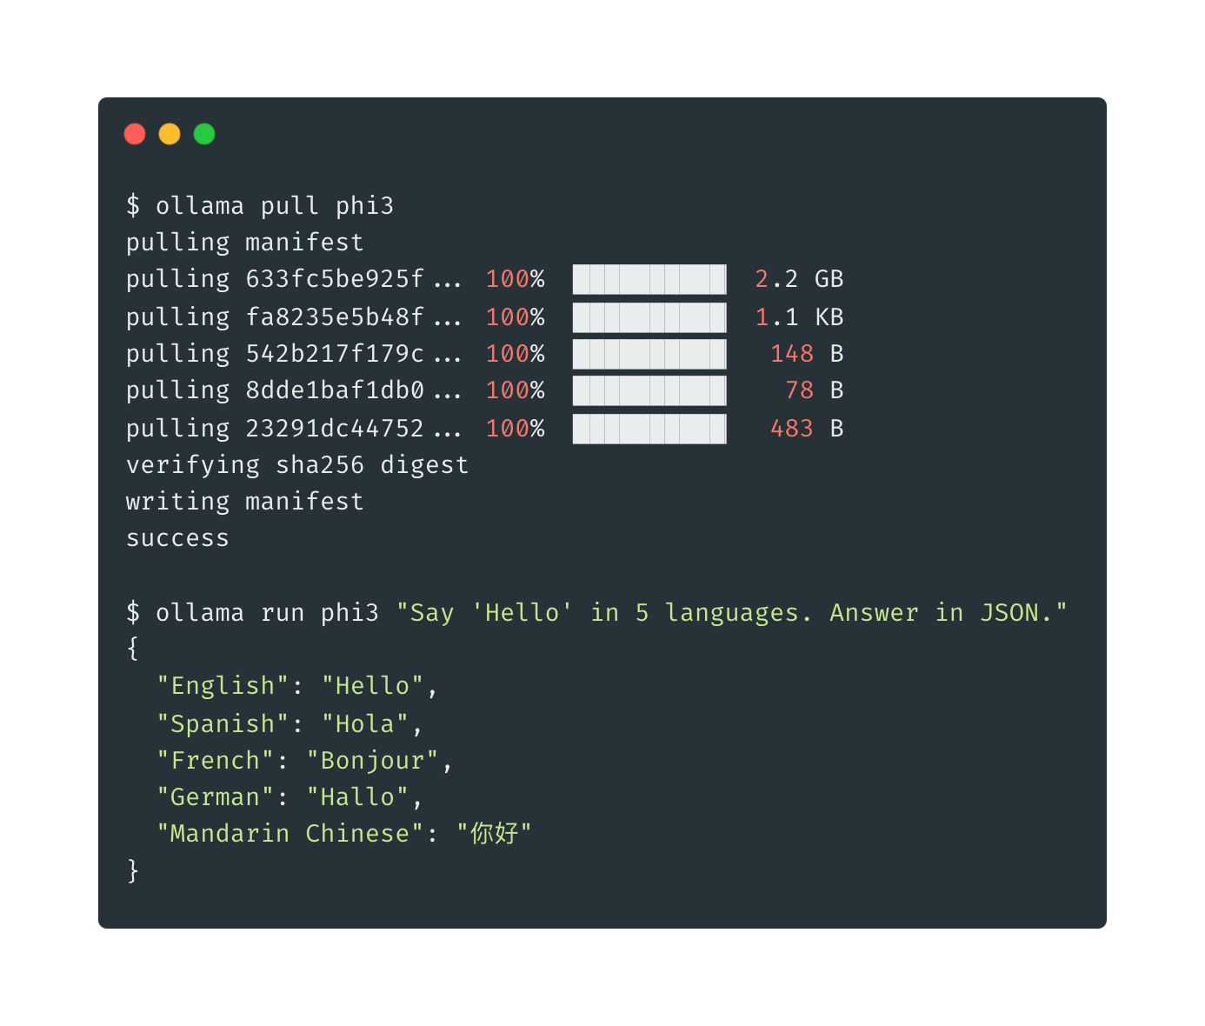

ollama
Open-source
CLI + HTTP API
Download and run open LLM
Generate embeddings
OpenAI compatible API
https://ollama.com/
Notes:
Quick démo Ollama (demo2)
Ollama est un projet open source qui permet de télécharger, gérer et exécuter des LLM sur votre machine en local locale.
– Olivier
# Demo
- `ollama list`
- `ollama run phi3` => write an haiku about a hungry camel
- Open `ollama.http` and mention OpenAI API compatibility

Slide 20
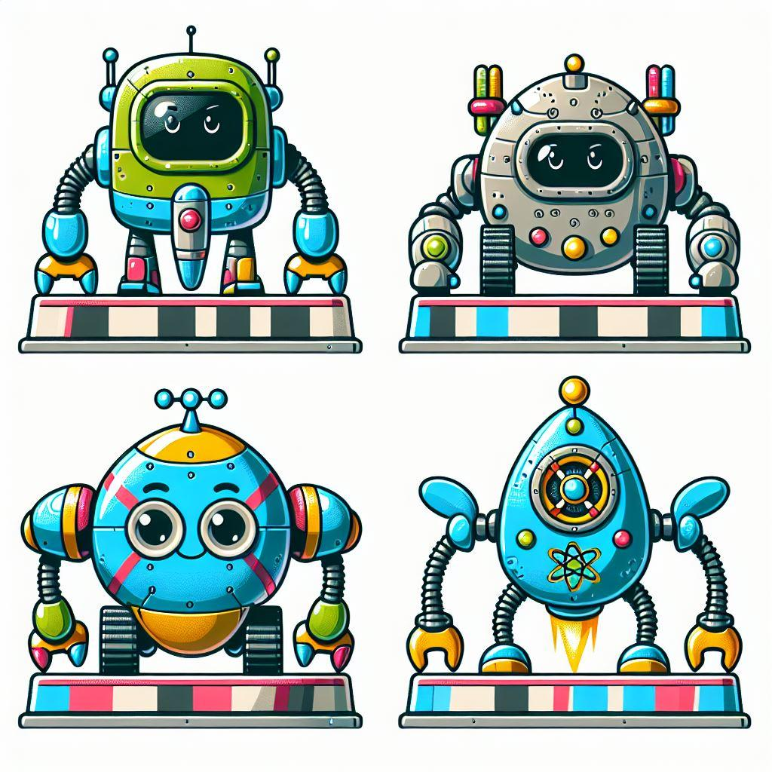
Comparison of prompts / models
Notes:
Olivier - 25-30min
# Demo 3
- Start from scratch (delete promptfooconfig.yaml)
- `promptfoo init` => choose compare models
- update config:
```
providers:
- ollama:chat:llama3.1
defaultTest:
options:
provider: file://../gpt4o-mini.yaml
```
- `promptfoo eval`
- `promptfoo view -y`
- `promptfoo eval --repeat 3`
- `promptfoo view -y`
- update config, add providers:
```
- ollama:chat:phi3:mini-4k
- ollama:chat:llama3.1
- ollama:chat:gemma2:2b
```
- `promptfoo eval`
- `promptfoo view -y`
Show bedrock config file and show that we can add configuration
Add the file in the providers list
Run “promptfoo eval”
Show browser

Slide 21
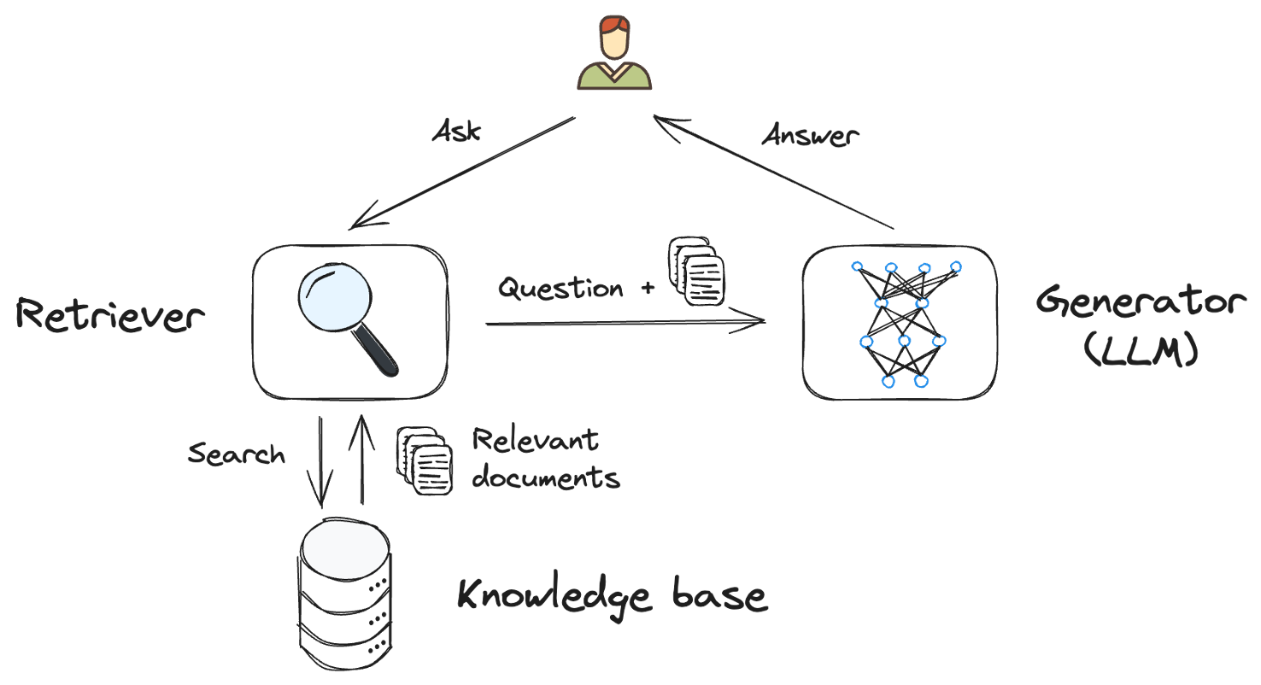
RAG evaluation
Retriever
Context recall
Context precision
Generator
Faithfulness
QA Correctness
Relevance
Notes:
Yohan - 35min
A mentionner:
https://ragas.io/ => specialisé dans l’évaluation des patterns RAG (Python)
https://github.com/Azure-Samples/ai-rag-chat-evaluator
# Demo 4
- This time, we want to evaluate a RAG prompt
- Open `prompt.md`
- RAG works on a given context, so we also have to provide a context
* Open `context.md`
* We hardcoded the context here, so we can focus on testing the prompt/models
* We won't cover that here, but you can go further and test the retrieval part, for example to compare embedding models
- Open `promptfooconfig.yaml` and explain the configuration
- `promptfoo eval`
- `promptfoo view -y`
* show a bit the eval output
* show a previous run with repeat 20

Slide 22
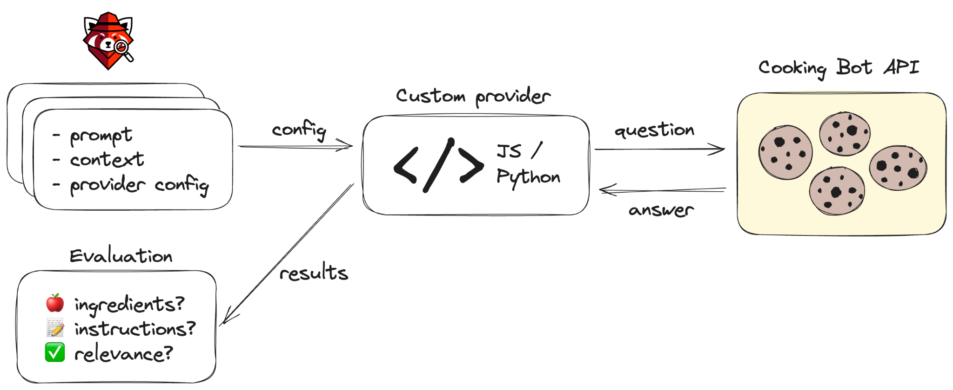
Testing custom HTTP endpoints
Notes:
Yohan - 40min
# Demo 5
- I want to test a custom HTTP endpoint
* you could either use the HTTP provider
* or implement custom logic with Python or JS
* we'll use JS here
- Open `api.http` and explain what our API does
- Open `cooking-api.js` and explain the code
- `promptfoo eval`
- `promptfoo view -y`

Slide 23
Recap
Don’t tie your app to a specific model ⇒ use abstraction layers or frameworks
Non-code needs testing too!
Gen AI is compatible with TDD 🔴 🟢 ♻️
Notes:
Model choice can vary over time, and it should be a productionizing decision, not a choice your make before building your app => use frameworks!
If you can validate that a smaller model works as well for your use case, you can save $$$

Slide 24
“
When leveraging LLMs and dealing with variable outputs, success hinges on one principle: relentless testing.
— ChatGPT
Notes:
Let’s conclude with citation from a great mind

Slide 25
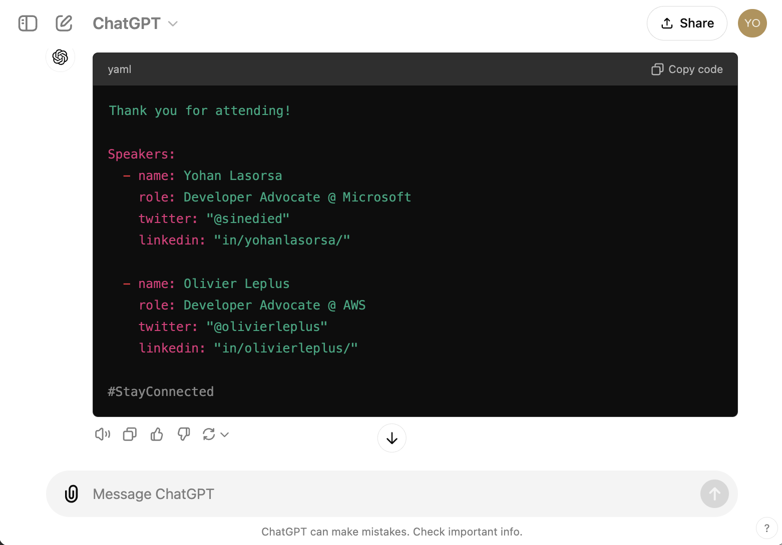

Feedbacks ⬇️

Slide 26
Notes:
Repo: https://github.com/sinedied/ai-eval-talk
### Plan
- https://www.promptfoo.dev/
- https://github.com/tensorchord/Awesome-LLMOps
- https://lmarena.ai/?leaderboard
## Intro
- LLM leaderboard, benchmarks: qui a la plus grosse?
- Faire tourner un modèle en local: quantizations, formats, performance et différences d'implémentation
- Quid de la qualité? Pourquoi c'est pas pareil que sur le leaderboard?
- 1er problème: comment on choisit un modèle? ie les leaderboards vs la perf "chez moi"
- Enfin, le use case. Les modèles sont peut être bons, mais pour votre cas d'usage?
- 2e problème: comment on évalue un modèle pour son cas d'usage?
- Prompt engineering, oui mais...
- Comment on s'assure que le changement de prompt est bon, et que ce n'est pas juste un coup de chance?
- Comment on évalue la qualité des réponses?
- 3e problème: comment on fait de la non-regression, a la fois sur les evolutions de prompts et les mise à jour de modèles?
=> Maintenant qu'on a posé les base
## Choosing a model
- LLM leaderboard, common benchmarks sets used
- Choosing a model should be a productionzing decision, not a stack choice
* Architecture your apps so you can switch models easily
## Evaluating a model
### Methods
- Pairwise comparison
- Vector similarity
- Levenshtein distance
- Criteria/Metrics + scoring
=> LLM as judge: using AI to evaluate AI
### Tools
- "OSS" somewhat
* https://github.com/confident-ai/deepeval
* https://github.com/evidentlyai/evidently
* https://github.com/deepchecks/deepchecks
- Langchain, MLFlow evaluators
- custom!
- promptfoo
* Deep dive + example
### Quality + non regression
* find examples of bad answers + improve prompts
* compare models for same prompt
* compare same model with different versions (llama2 vs llama3?)
* optimize cost? smaller models can be enough

